Slide 1
ENGR 12
Dr. Mandala
Notes:
Down

Slide 2
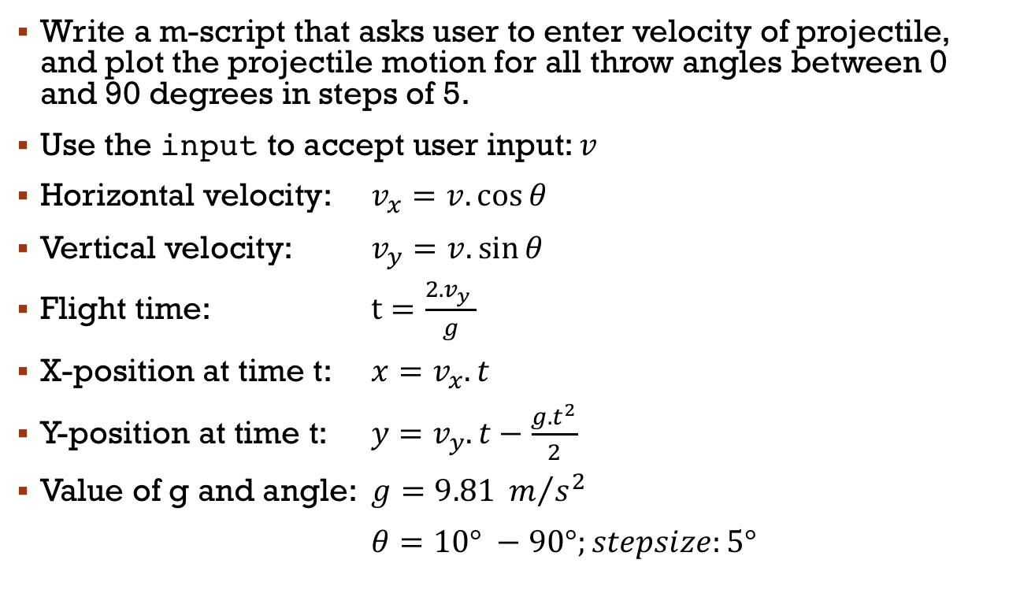
In your teams
Write a m-script that asks user to enter velocity of projectile, and plot the projectile motion for all throw angles between 0 and 90 degrees in steps of 5.
Use the input to accept user input: $v$
Horizontal velocity: $v_{x}=v.\cos{θ}$
Vertical velocity: $v_{y}=v.\sin{θ}$
Flight time: $t=\frac{2.v_{y} }{g}$
X-position at time t: $x=v_{x}.t$
Y-position at time t: $y=v_{y}.t−\frac{{g.t}^{2}}{2}$
Value of g and angle: $g=9.81 m/{s^{2}}$
$θ=10° −90°;stepsize:5°$

Slide 3
User-defined functions
Functions look exactly like scripts, but for one difference: functions must have a function declaration
function [x, y, z…] = myFunction(in1, in2, in3…)
Note: MATLAB returns the variables whose names match those in the function declaration. Variables created within the function but not returned disappear after the function stops running
Required MATLAB reserved word
Function name—should match file name i.e; myFunction.m
Function outputs; if more than one, use brackets [ ]
Function inputs

Slide 4
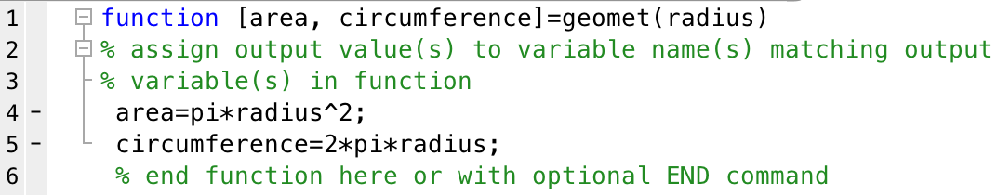
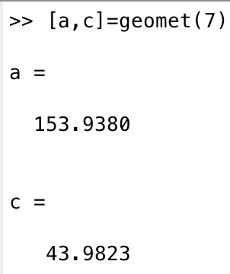
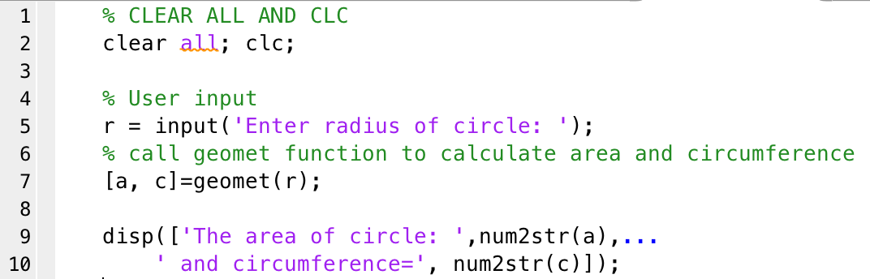
Sample code
Function call either through command prompt or within another MATLAB script

Slide 5
Work in your teams to answer
Can a function be defined with no input arguments?
YES
Can a function be defined with no output arguments?
YES

Slide 6
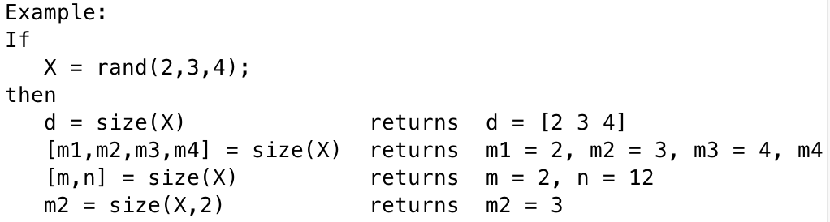
Function overloading
MATLAB allows functions to provide variable output and input i.e. variable number of outputs and inputs.
Example: MATLAB’s builtin SIZE command
Note how the same command is used with different output variable and input variable counts? This is termed overloading.

Slide 7
Function overloading
For variable output:
Use ‘varargout’ as a defined output variable in function definition.
Use ‘nargout’ to determine number of output variables used to invoke the function by user.
function varargout=filechk(fname,loc)
Somewhere in the function include: varargout={option1,option2…}
Then
>> [data, setval]=filechk(‘val.dat’,’C:’);
nargout = 2
NOTE: varargout should be defined within function as a cell array.

Slide 8
Function overloading
For variable input:
Use ‘varargin’ as a defined input variable in function definition.
Use ‘nargin’ to determine number of input variables used to invoke the function by user.
function data=filechk(varargin)
Then
>> data=filechk(‘val.dat’,’C:’,13);
nargin = 3
varargin={‘val.dat’,’C:’,13}
NOTE: varargin is a cell array containing variable values entered by user in function call

Slide 9
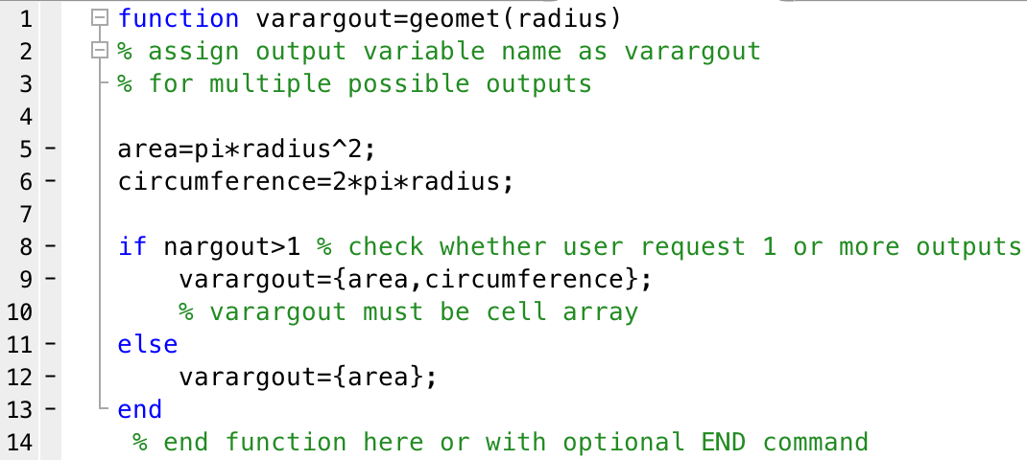
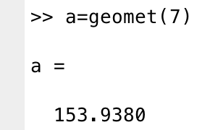
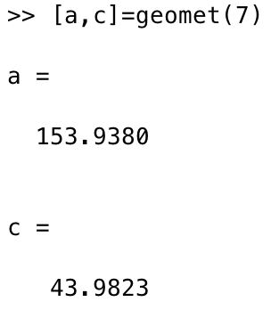
This shit will be on the test

Slide 10
Questions…
Can you have a combination of fixed and variable inputs for a function? What about fixed and variable outputs?

Slide 11
About functions
Functions end at end of file and return values in variables that match output variables in function definition.
You can use an optional END command to define the end of a function.
This becomes required when more than one function is defined in script!
You can also use the RETURN command to end the function and return values.
Strategically used to end a function earlier, say, when you detect an error in input.

Slide 12
Download handout
Download Handout

